Slide 1





RECOMMENDATION SYSTEM FOR OTT PLATFORM
Members,
Vaishnavi Shahu
Rajender Mudasthu
Raghavendra Betageri
Sai Charan
Hari Teja
Kousik Dutta
Guided By
Billa Venkata Satyanarayana
DE Expert

Slide 2
Objectives
To build the ETL pipelines for the Over-the-top (OTT) platform data from source to Cloud Services (Azure)
To analyze the Data from cloud using batch, and interactive.
Create a recommendation system for the users in the OTT platform services to increase the profit.

Slide 3
Data Description
Datasets Description -
Amazon_prime.csv:
(Movie_Name, Language, Rating, Runtime, Year, Age_rating, Review)
Number of Rows : 8127
Netflix.csv:
(Show_id, type, title, Director, Cast, Country, Date_added, Year, Age_rating, Duration, Listed_in, Description)
Number of Rows : 8808
Disney_plus.csv:
(Imdb_id, title, plot, type, age_rating, year, released_at, added_at, runtime, genre, Director, Writer, Actors, Language, Country, Awards, Metascore, Imdb_rating, imdb_votes)
Number of Rows : 895

Slide 4











Tools and Frameworks Used

Slide 5
Environment and Versions
Spark 3.3.2
Hive 1.1.0
Hadoop 2.6.0
Sqoop 1.4.6
MySQL 14.14
Databricks 12.2 - LTS (Long Term Support)
Power BI 2.119.986.0 64-bit

Slide 6











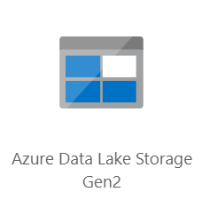




Azure Data Engineering Solution Architecture for the current project
Storage and Processing
Data Source
Ingestion
Orchestration and Visualization
1
1
1
4
2
2
ADF
2
Monitor & Govern

Slide 7
Data Ingestion Pipeline
Source
Azure SQL DB
Sink
ADLS
ADF

Slide 8
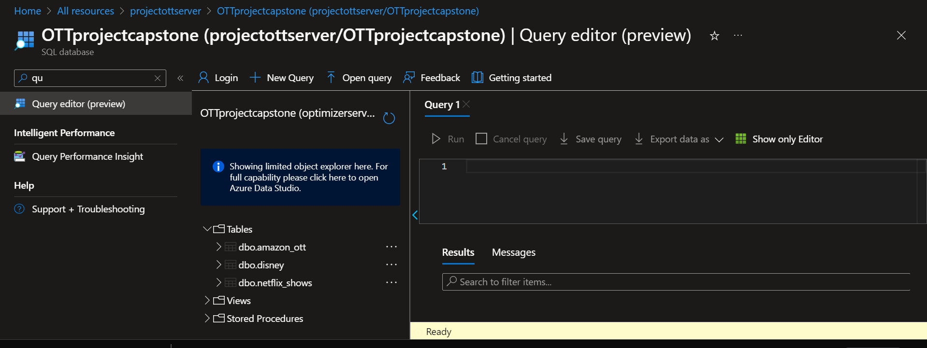
Source (Azure SQL DB) to Sink (ADLS) Pipeline
Data is in Azure SQL DB, This is our source

Slide 9
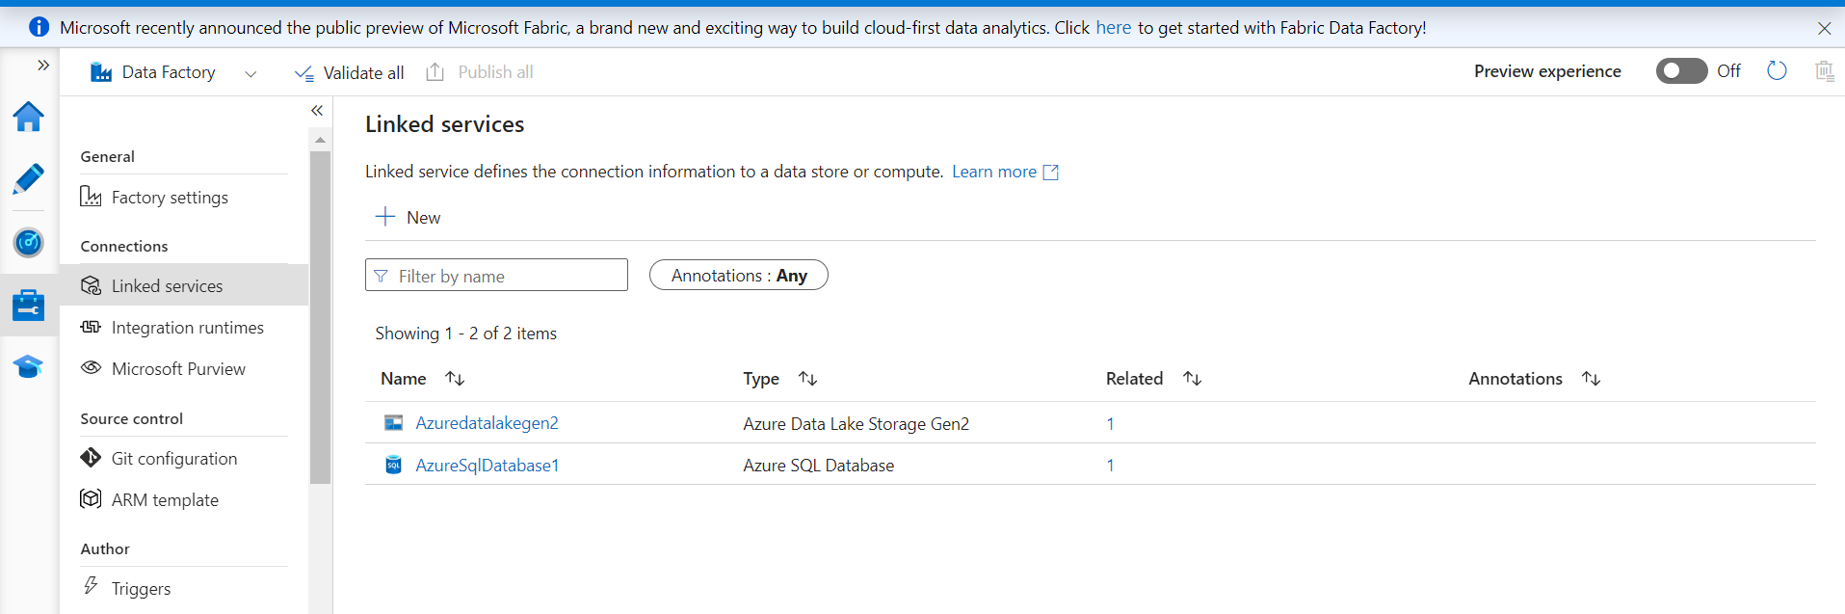
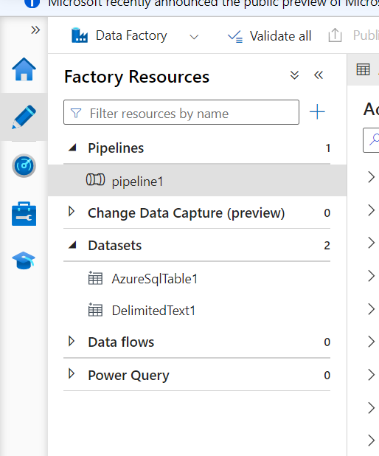
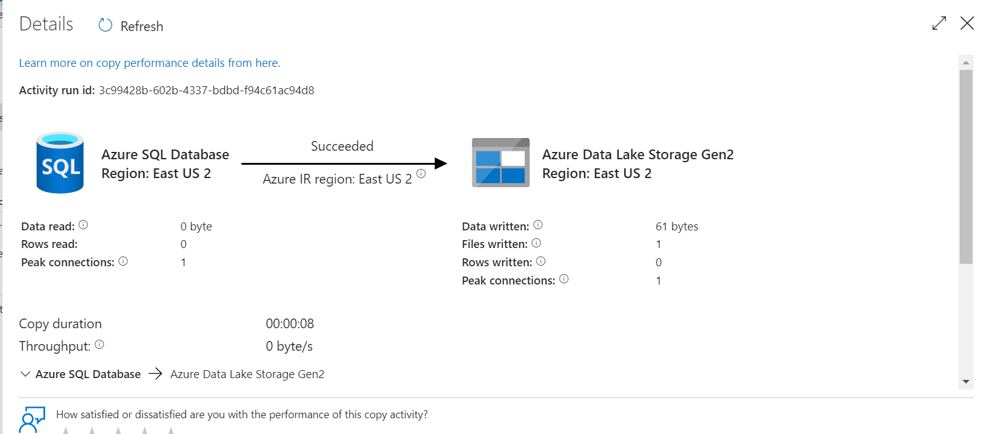
Go to Managed in ADF, create 2 linked services
Creating for-each activity to bring multiple files from SQL DB to ADLS and pipeline as shown

Slide 10
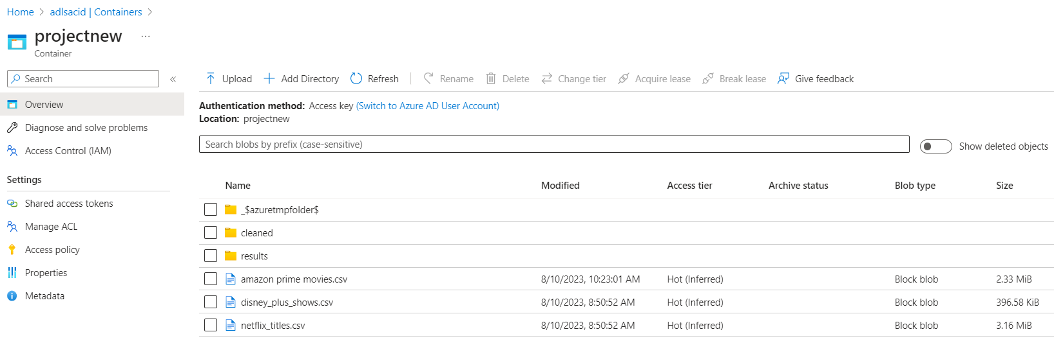
Here we have files in ADLS.
The other folders have been made after running the transformations and Scenarios.

Slide 11
Architecture & Analysis Using HIVE
Storage/
Analysis
HDFS
Power BI
Hive Analysis
Source MySQL
Sqoop
Process
Ran Sqoop Pipeline to Bring Data From MySql to HIVE
Created internal table
Analyzed 5 scenarios
Optimization techniques: Partitioning and bucketing, file formatting
Comparison
Exporting to RDBMS
Connecting RDBMS to power BI

Slide 12
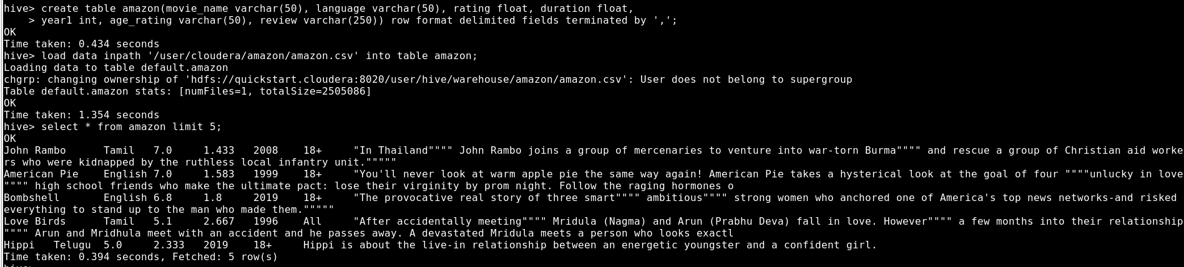
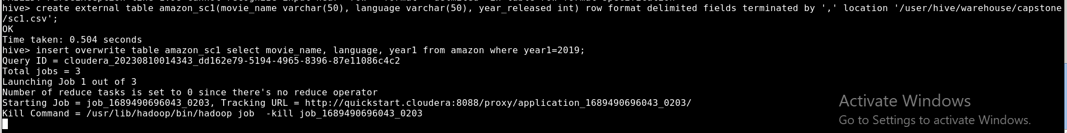
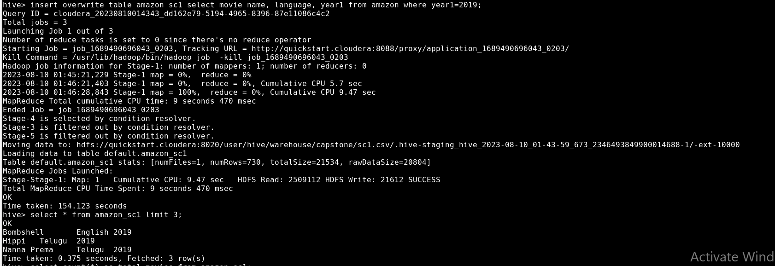
Created internal table, scenarios
Scenario-1 from Amazon with out optimization techniques
1.Review the movie names and languages names in the year of 2019.

Slide 13
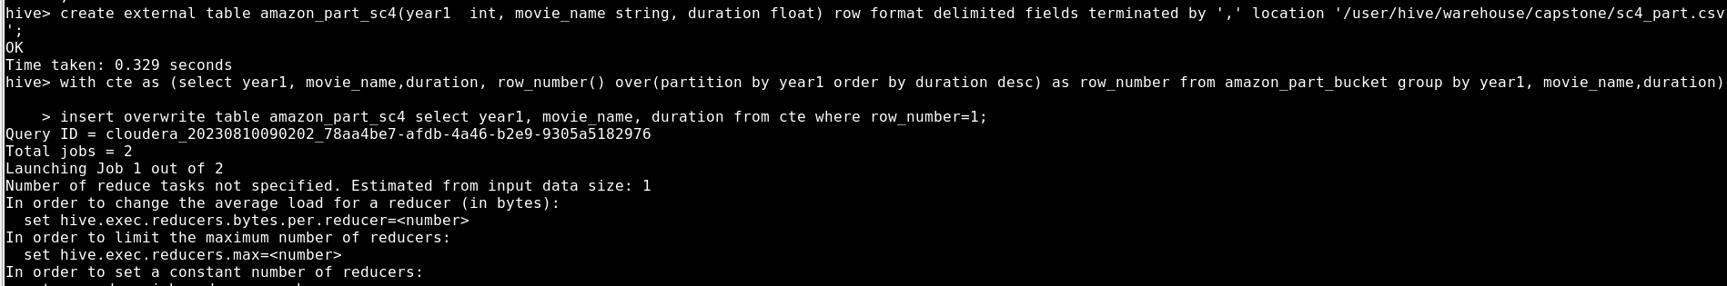
Scenario 1 using Partitioning & Bucketing Optimization
Partitioning & Bucketing Code :
CREATE Table amazon_part_bucket (movie_name string, language string, rating float, duration float, age_rating string, review string) Partitioned by (year1 int) clustered by (age_rating) into 6 buckets row format delimited fields terminated by “,”;
Code:
create external table amazon_part_sc1(movie_name varchar(50), language varchar(50), yea`r_released int) row format delimited fields terminated by ',' location '/user/hive/warehouse/capstone/sc1_part.csv';
insert overwrite table amazon_part_sc1 select movie_name, language, year1 from amazon_part_bucket where year1=2019;

Slide 14
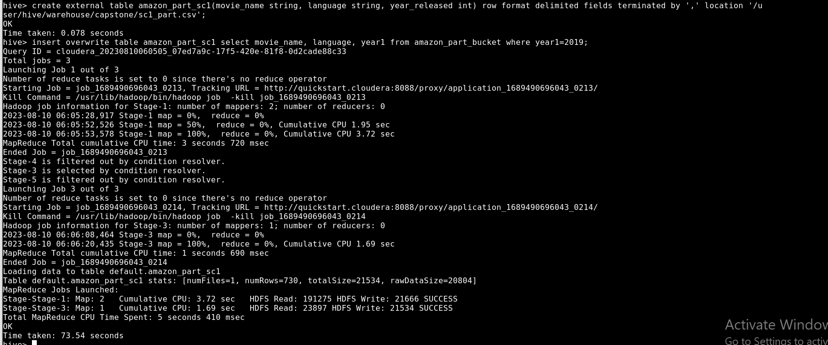
Scenario 1
Review the movie names and languages names in the year of 2019.
Code:
select movie_name, language, year1 from amazon where year1=2019;

Slide 15
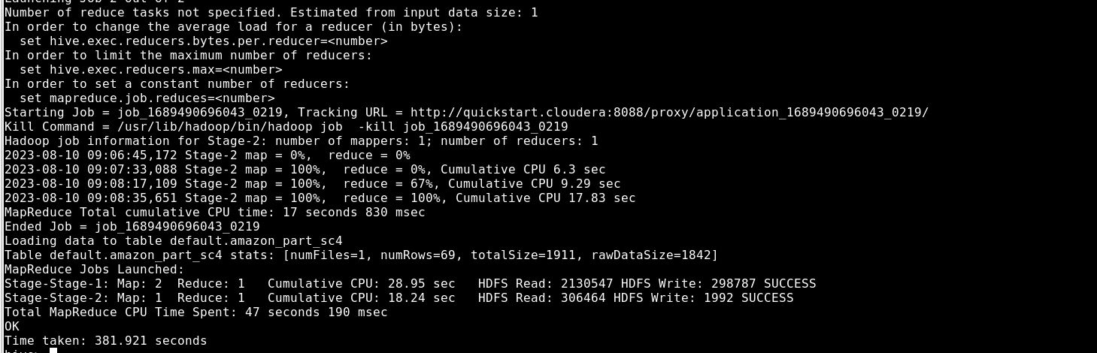
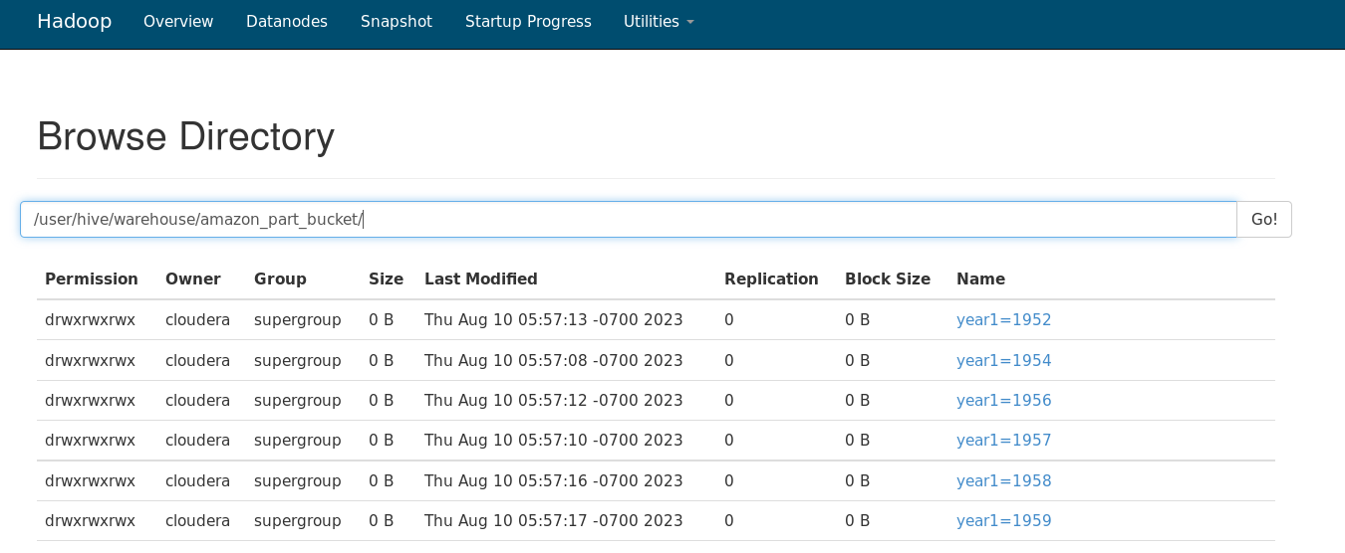
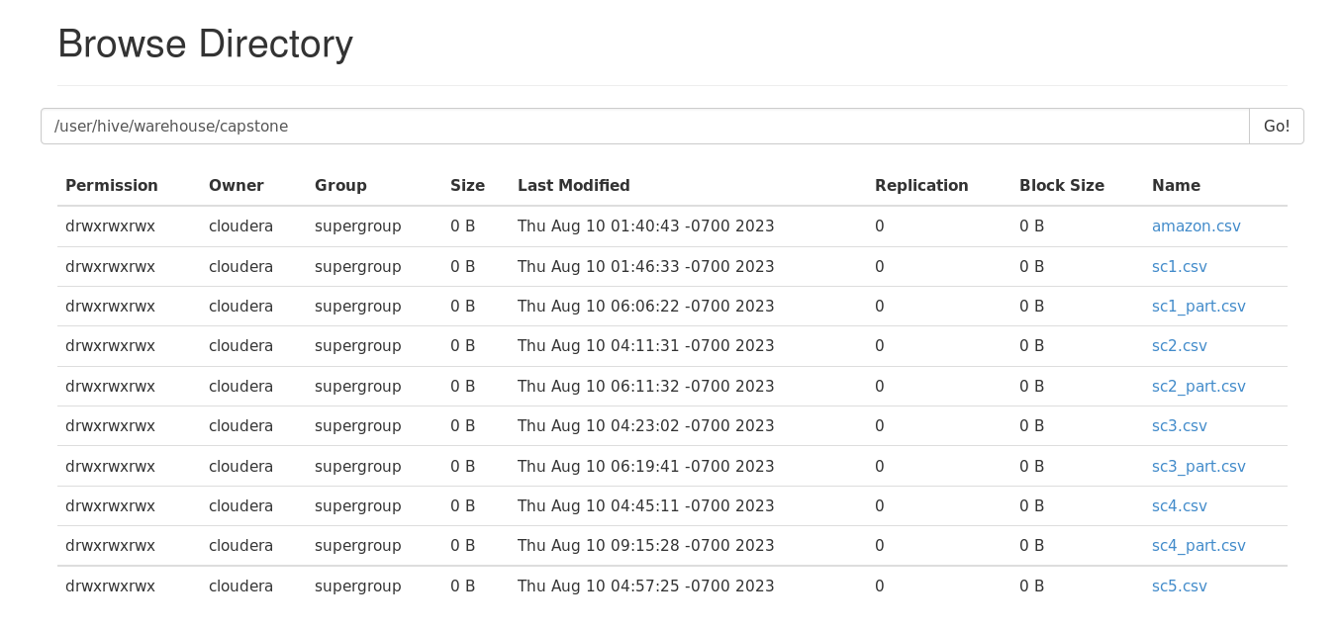
Scenario Results with Partitioning & Bucketing Optimization
Partitioning & Bucketing Result
Scenarios Results for Partitioning & Bucketing

Slide 16
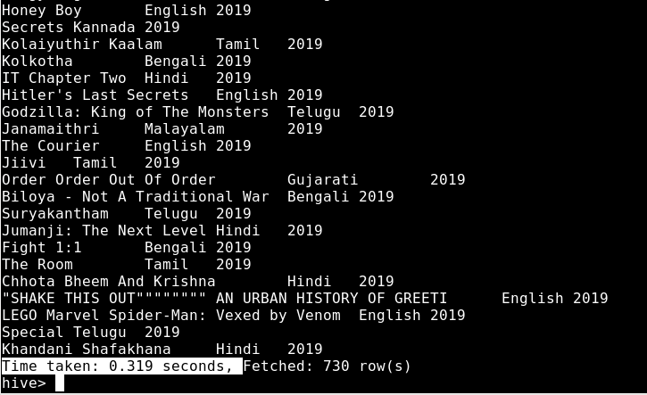
Scenario 1 using File Format Optimization
Code:
create table amazon_orc(movie_name string, language string, rating string, duration float, age_rating string, review string) stored as orc;
select movie_name, language, year1 from amazon_orc where year1=2019;

Slide 17
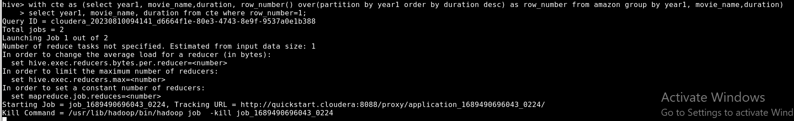
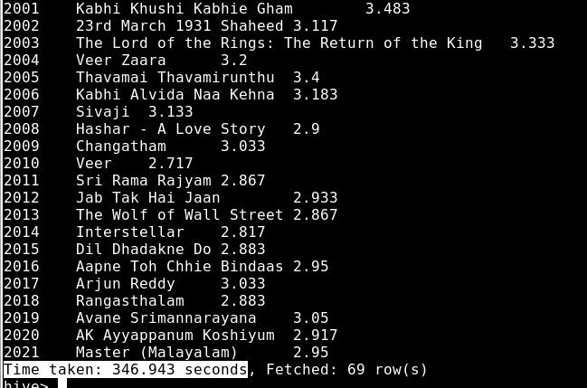
Scenario 4
Which movie has the highest running duration year-wise?
Code:
with cte as (select year1, movie_name,duration, row_number() over(partition by year1 order by duration desc) as row_number from amazon group by year1, movie_name,duration)
insert overwrite table amazon_sc4 select year1, movie_name, duration from cte where row_number=1;

Slide 18
Scenario 4 using Partitioning & Bucketing Optimization
Code:
with cte as (select year1, movie_name,duration, row_number() over(partition by year1 order by duration desc) as row_number from amazon_part_bucket group by year1, movie_name,duration)
insert overwrite table amazon_part_sc4 select year1, movie_name, duration from cte where row_number=1;

Slide 19
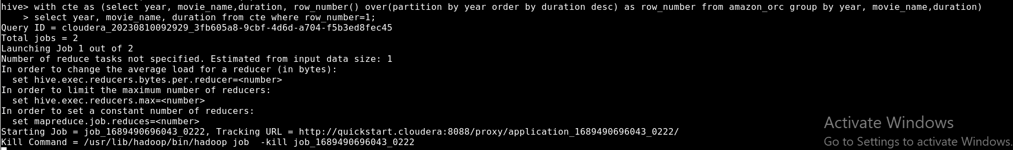
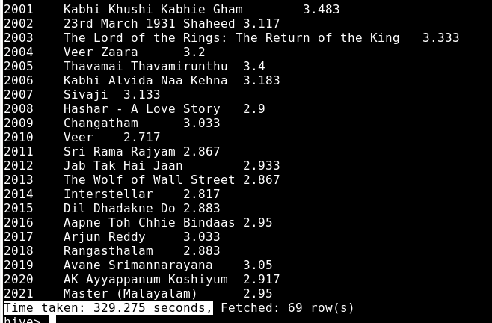
Scenario 4 using File Format Optimization
Code:
with cte as (select year, movie_name,duration, row_number() over(partition by year order by duration desc) as row_number from amazon_orc group by year, movie_name,duration)
select year, movie_name, duration from cte where row_number=1;

Slide 20
Comparison
Scenario from Amazon | Normal query time | With partitioning and bucketing time taken | File-formatting (ORC-file format) taken
1 | 154 sec | 73 sec | 0.319 sec
4 | 346 sec | 381 sec | 329 sec

Slide 21
Architecture & Analysis Using Databricks
Databricks
Azure Synapse
Power BI
ADLS
ADF
Process | Language | Scenarios
Interactive processing | SparkSQL | All scenarios
Batch processing | DSL | 3 scenarios
Batch processing | RDD | 5 scenarios
Batch processing | Hive | 5 scenarios

Slide 22
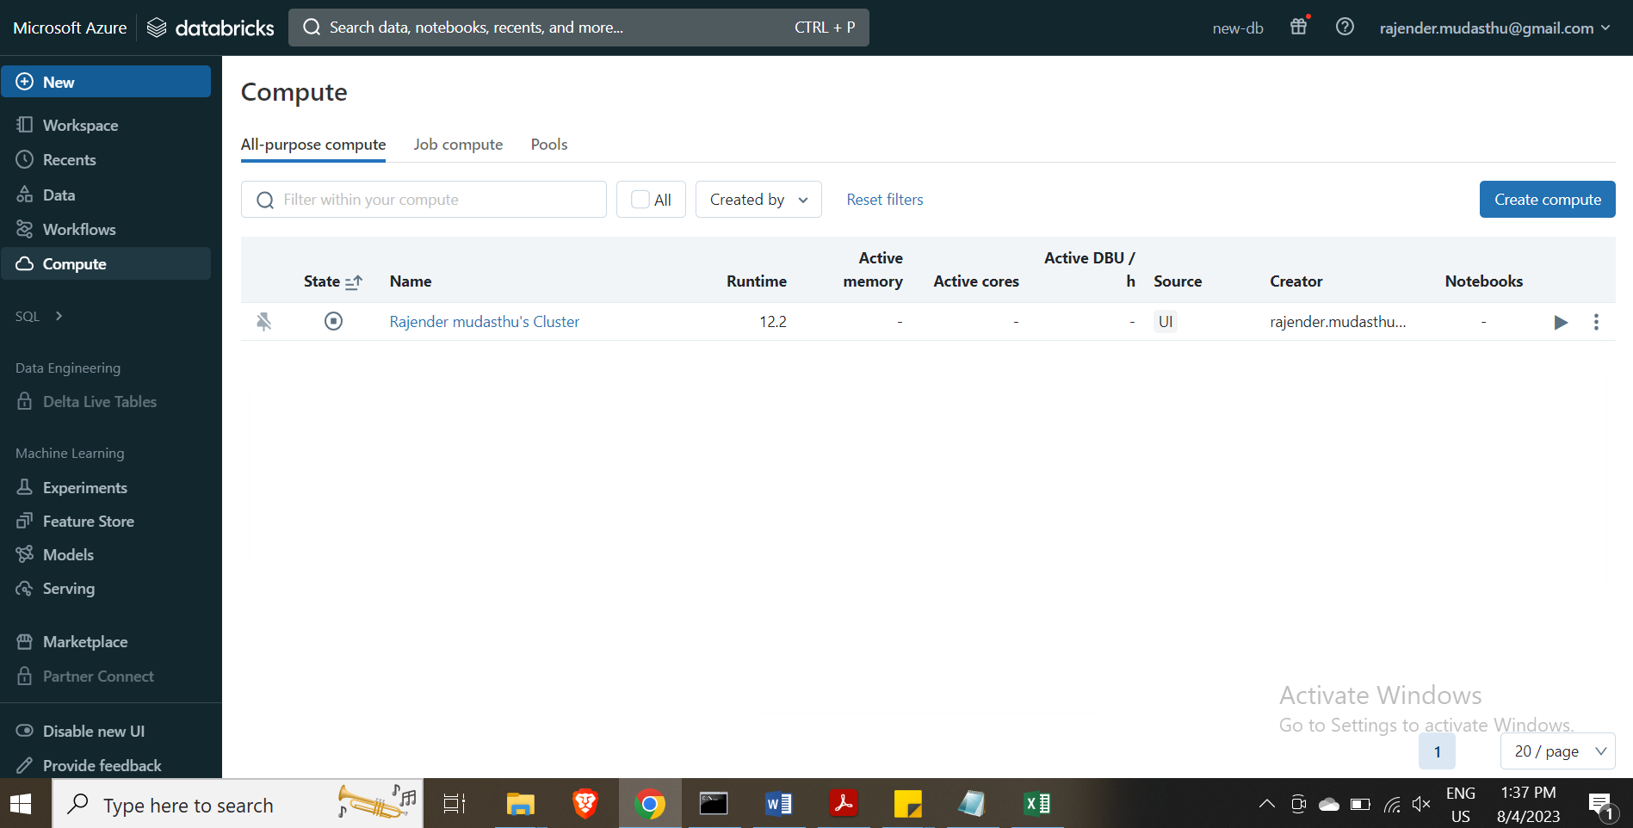
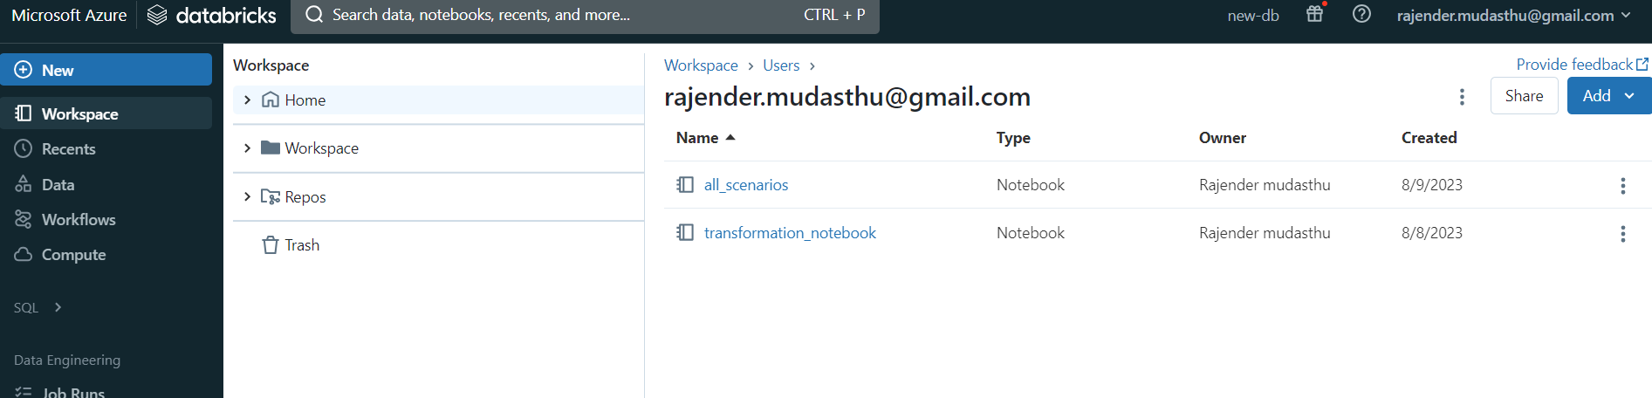
Databricks
Databricks Cluster Launch
Cluster Configuration :
1 Node, 4 Cores & 8 GB RAM
Databricks Mounted On :
ADLS Storage Account
Notebook Links -
Transformed Notebook
Scenarios Notebook

Slide 23
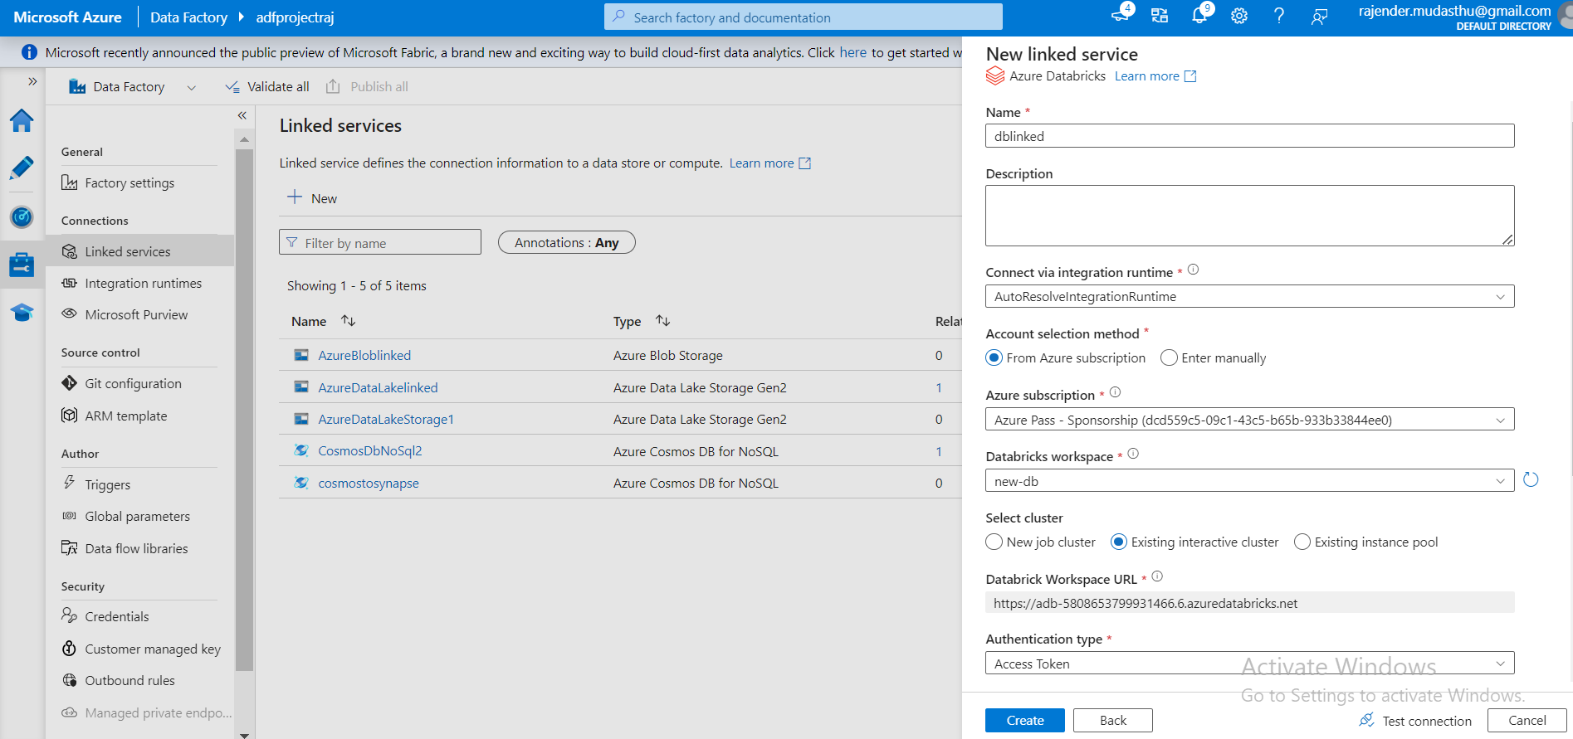
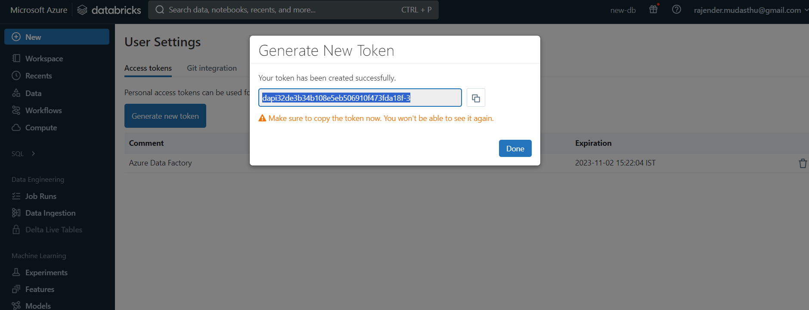
Running the pipeline with ADF for the 2 notebooks
Creating linked service for the notebooks

Slide 24
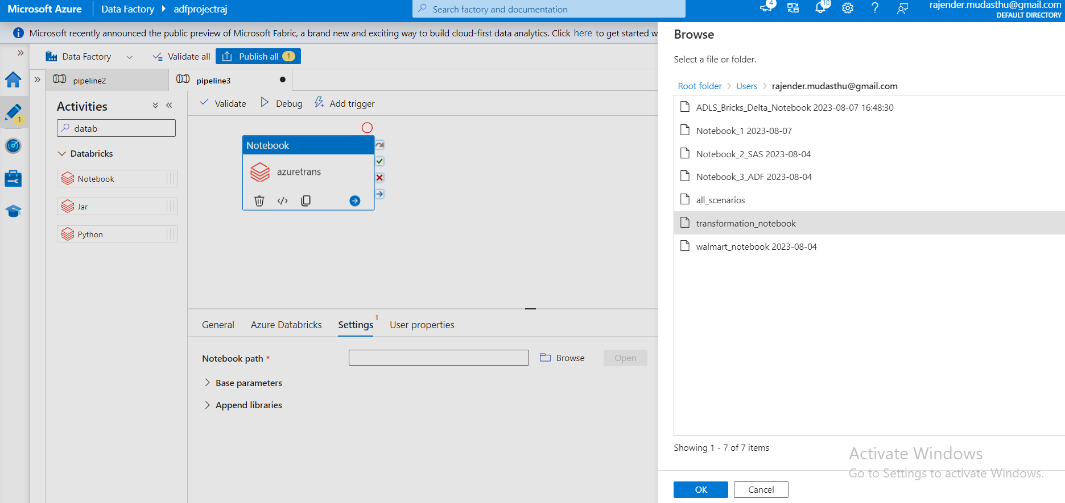
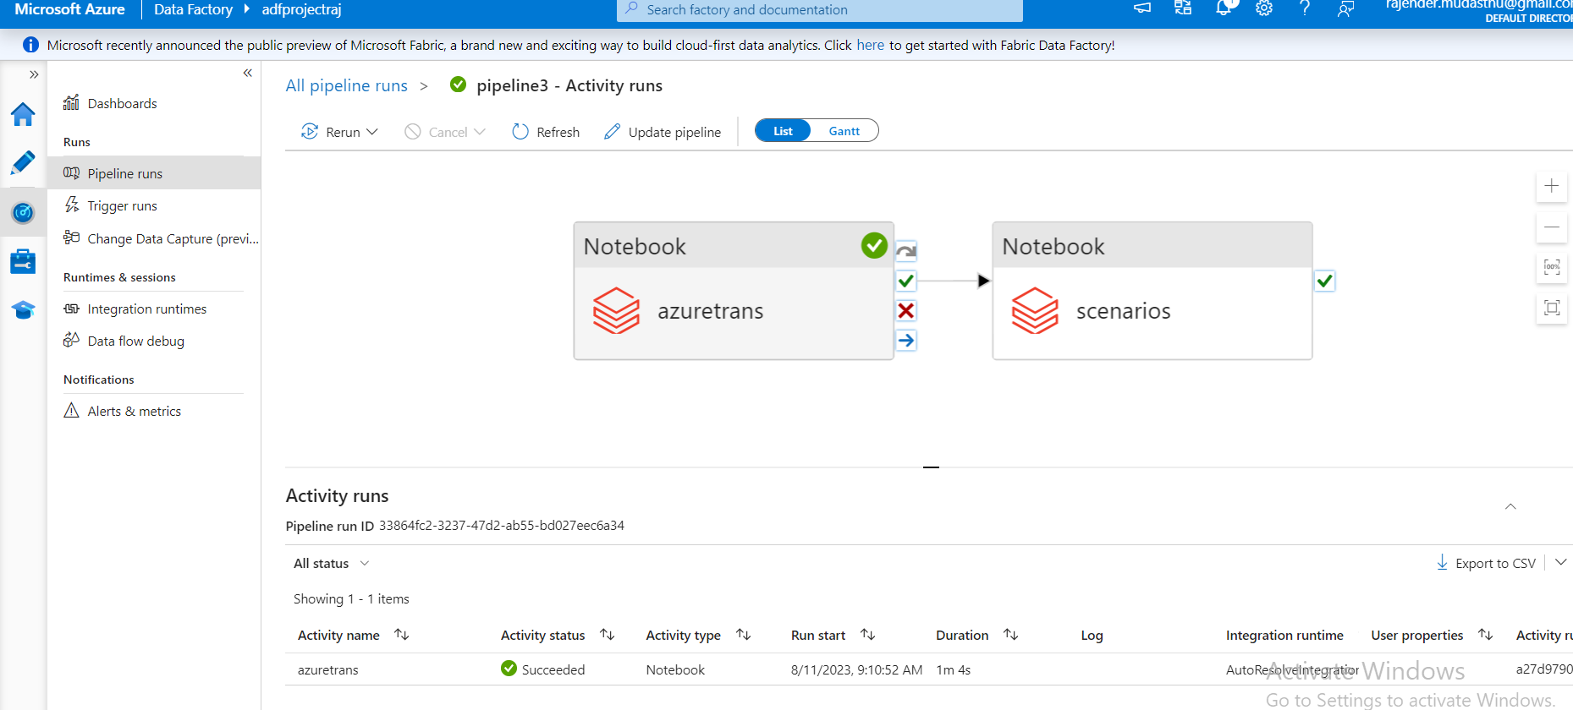
Selecting Notebooks & Running Pipelines
Here Transformation & Analysis notebooks were connected
Pipeline scheduling according to the requirement
Both Transformation & Analysis notebooks were being run at a time
The output of the notebooks will be saved in ADLS as pre planned in the notebooks

Slide 25
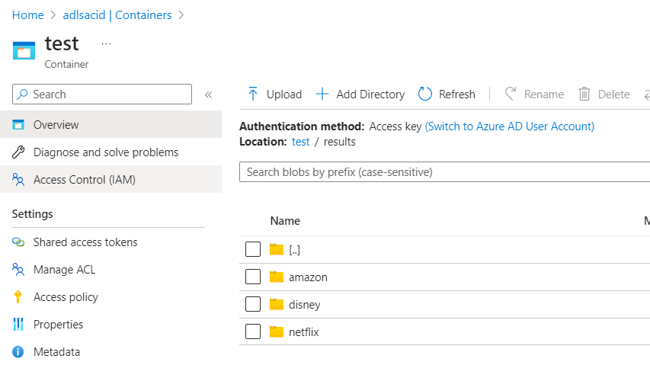
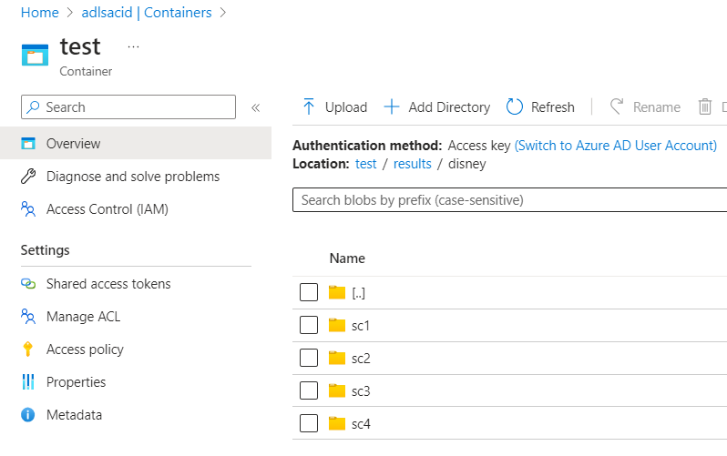
Checking the Output in ADLS

Slide 26
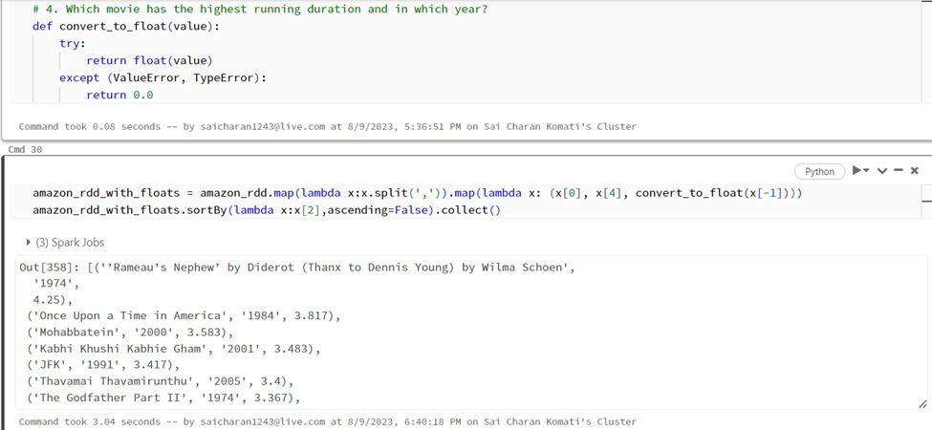
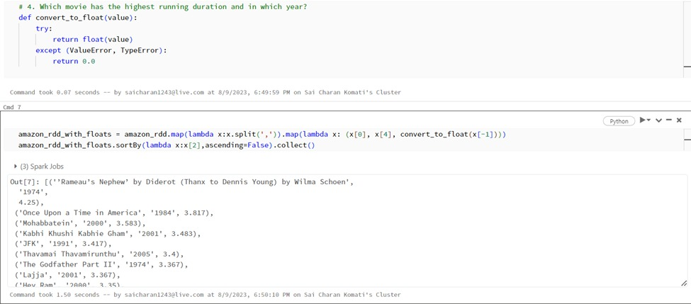
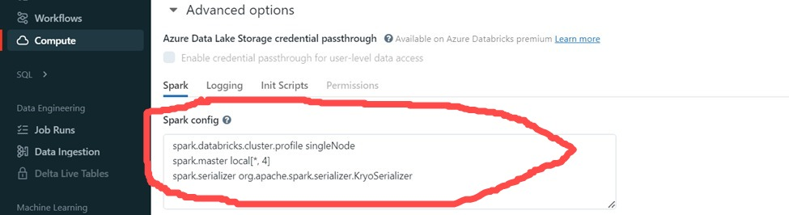
Optimization Techniques in RDD

Slide 27
NoSQL DB Architecture & Analysis Using Cosmos DB
ADLS
ADF
Cosmos DB
Synapse Analytics

Slide 28
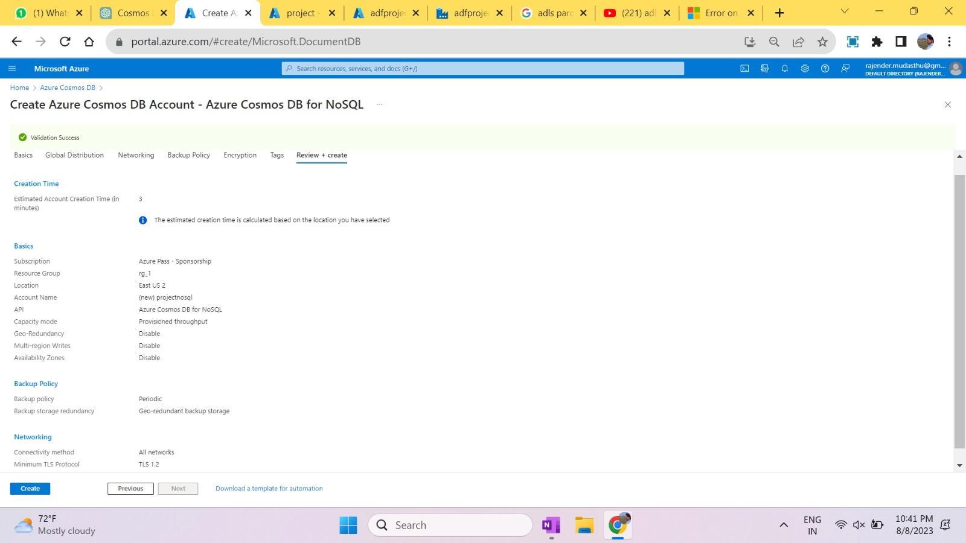
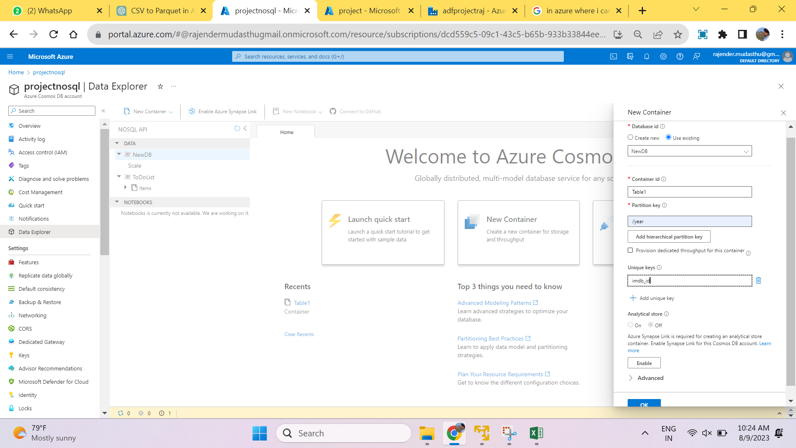
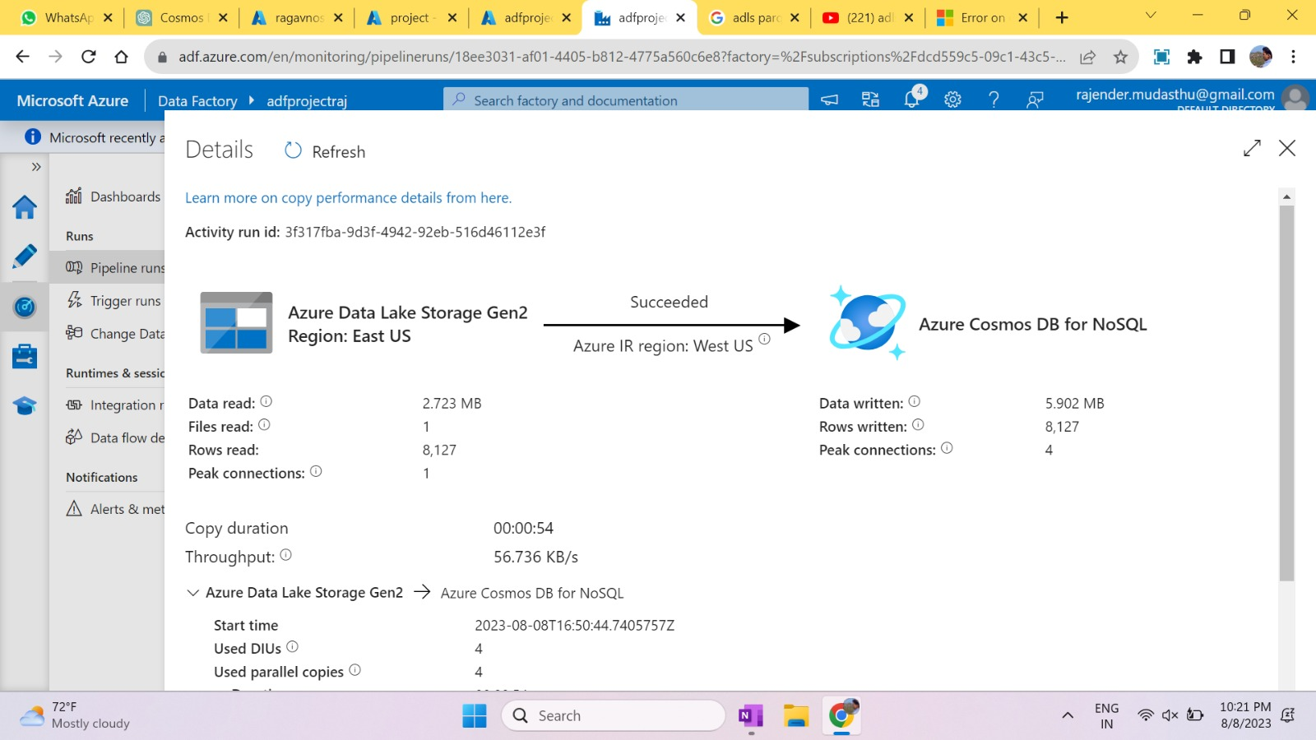
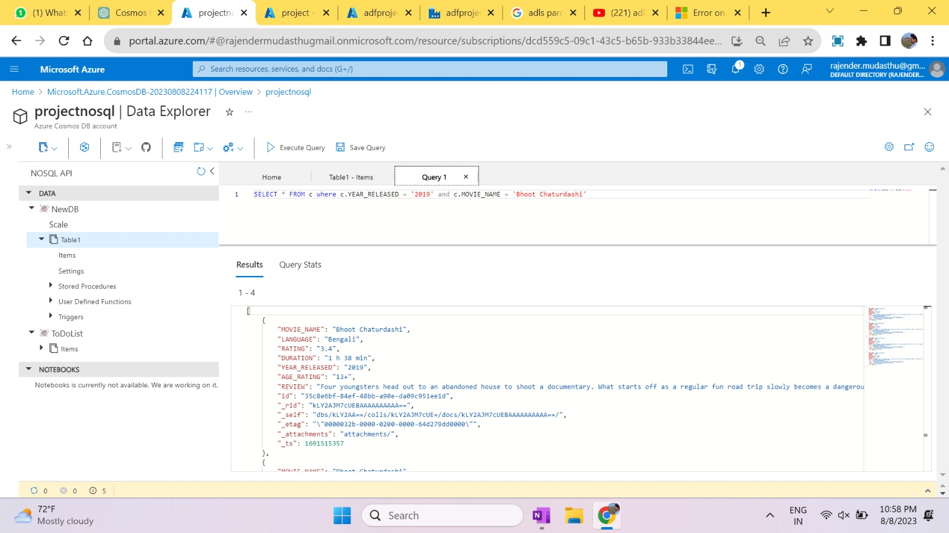

Slide 29
Let’s Go to PowerBI to see some Insights

Slide 30
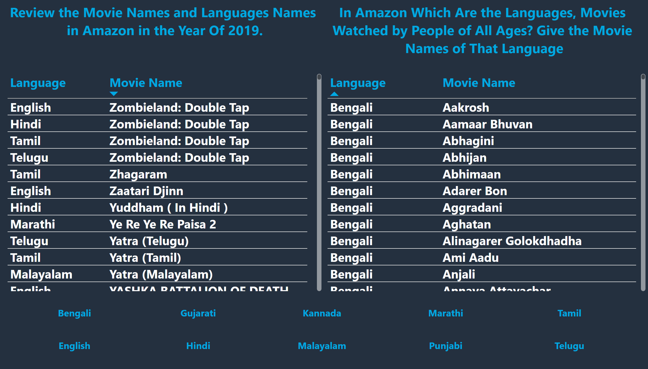
Amazon 1, 2
Notes:
textbox
No alt text provided
tableEx
No alt text provided
slicer
No alt text provided
textbox
No alt text provided
tableEx
No alt text provided

Slide 31
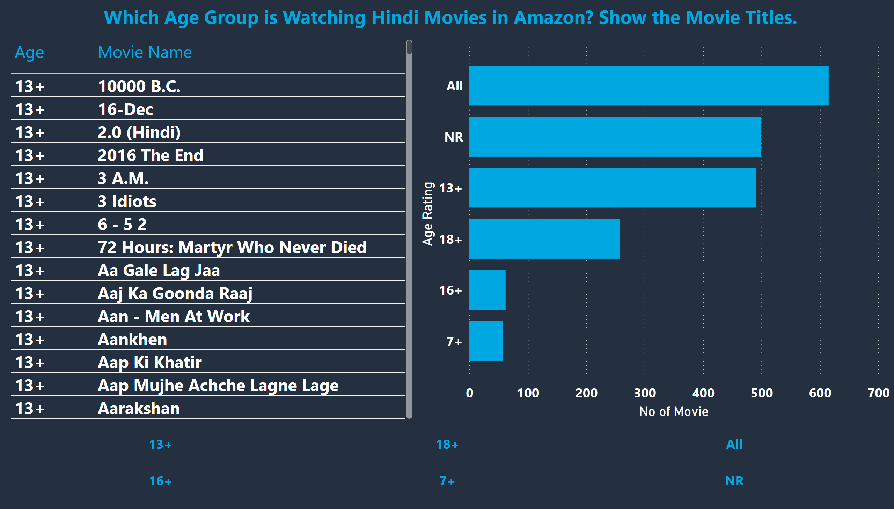
Amazon 3
Notes:
textbox
No alt text provided
tableEx
No alt text provided
slicer
No alt text provided
barChart
No alt text provided

Slide 32
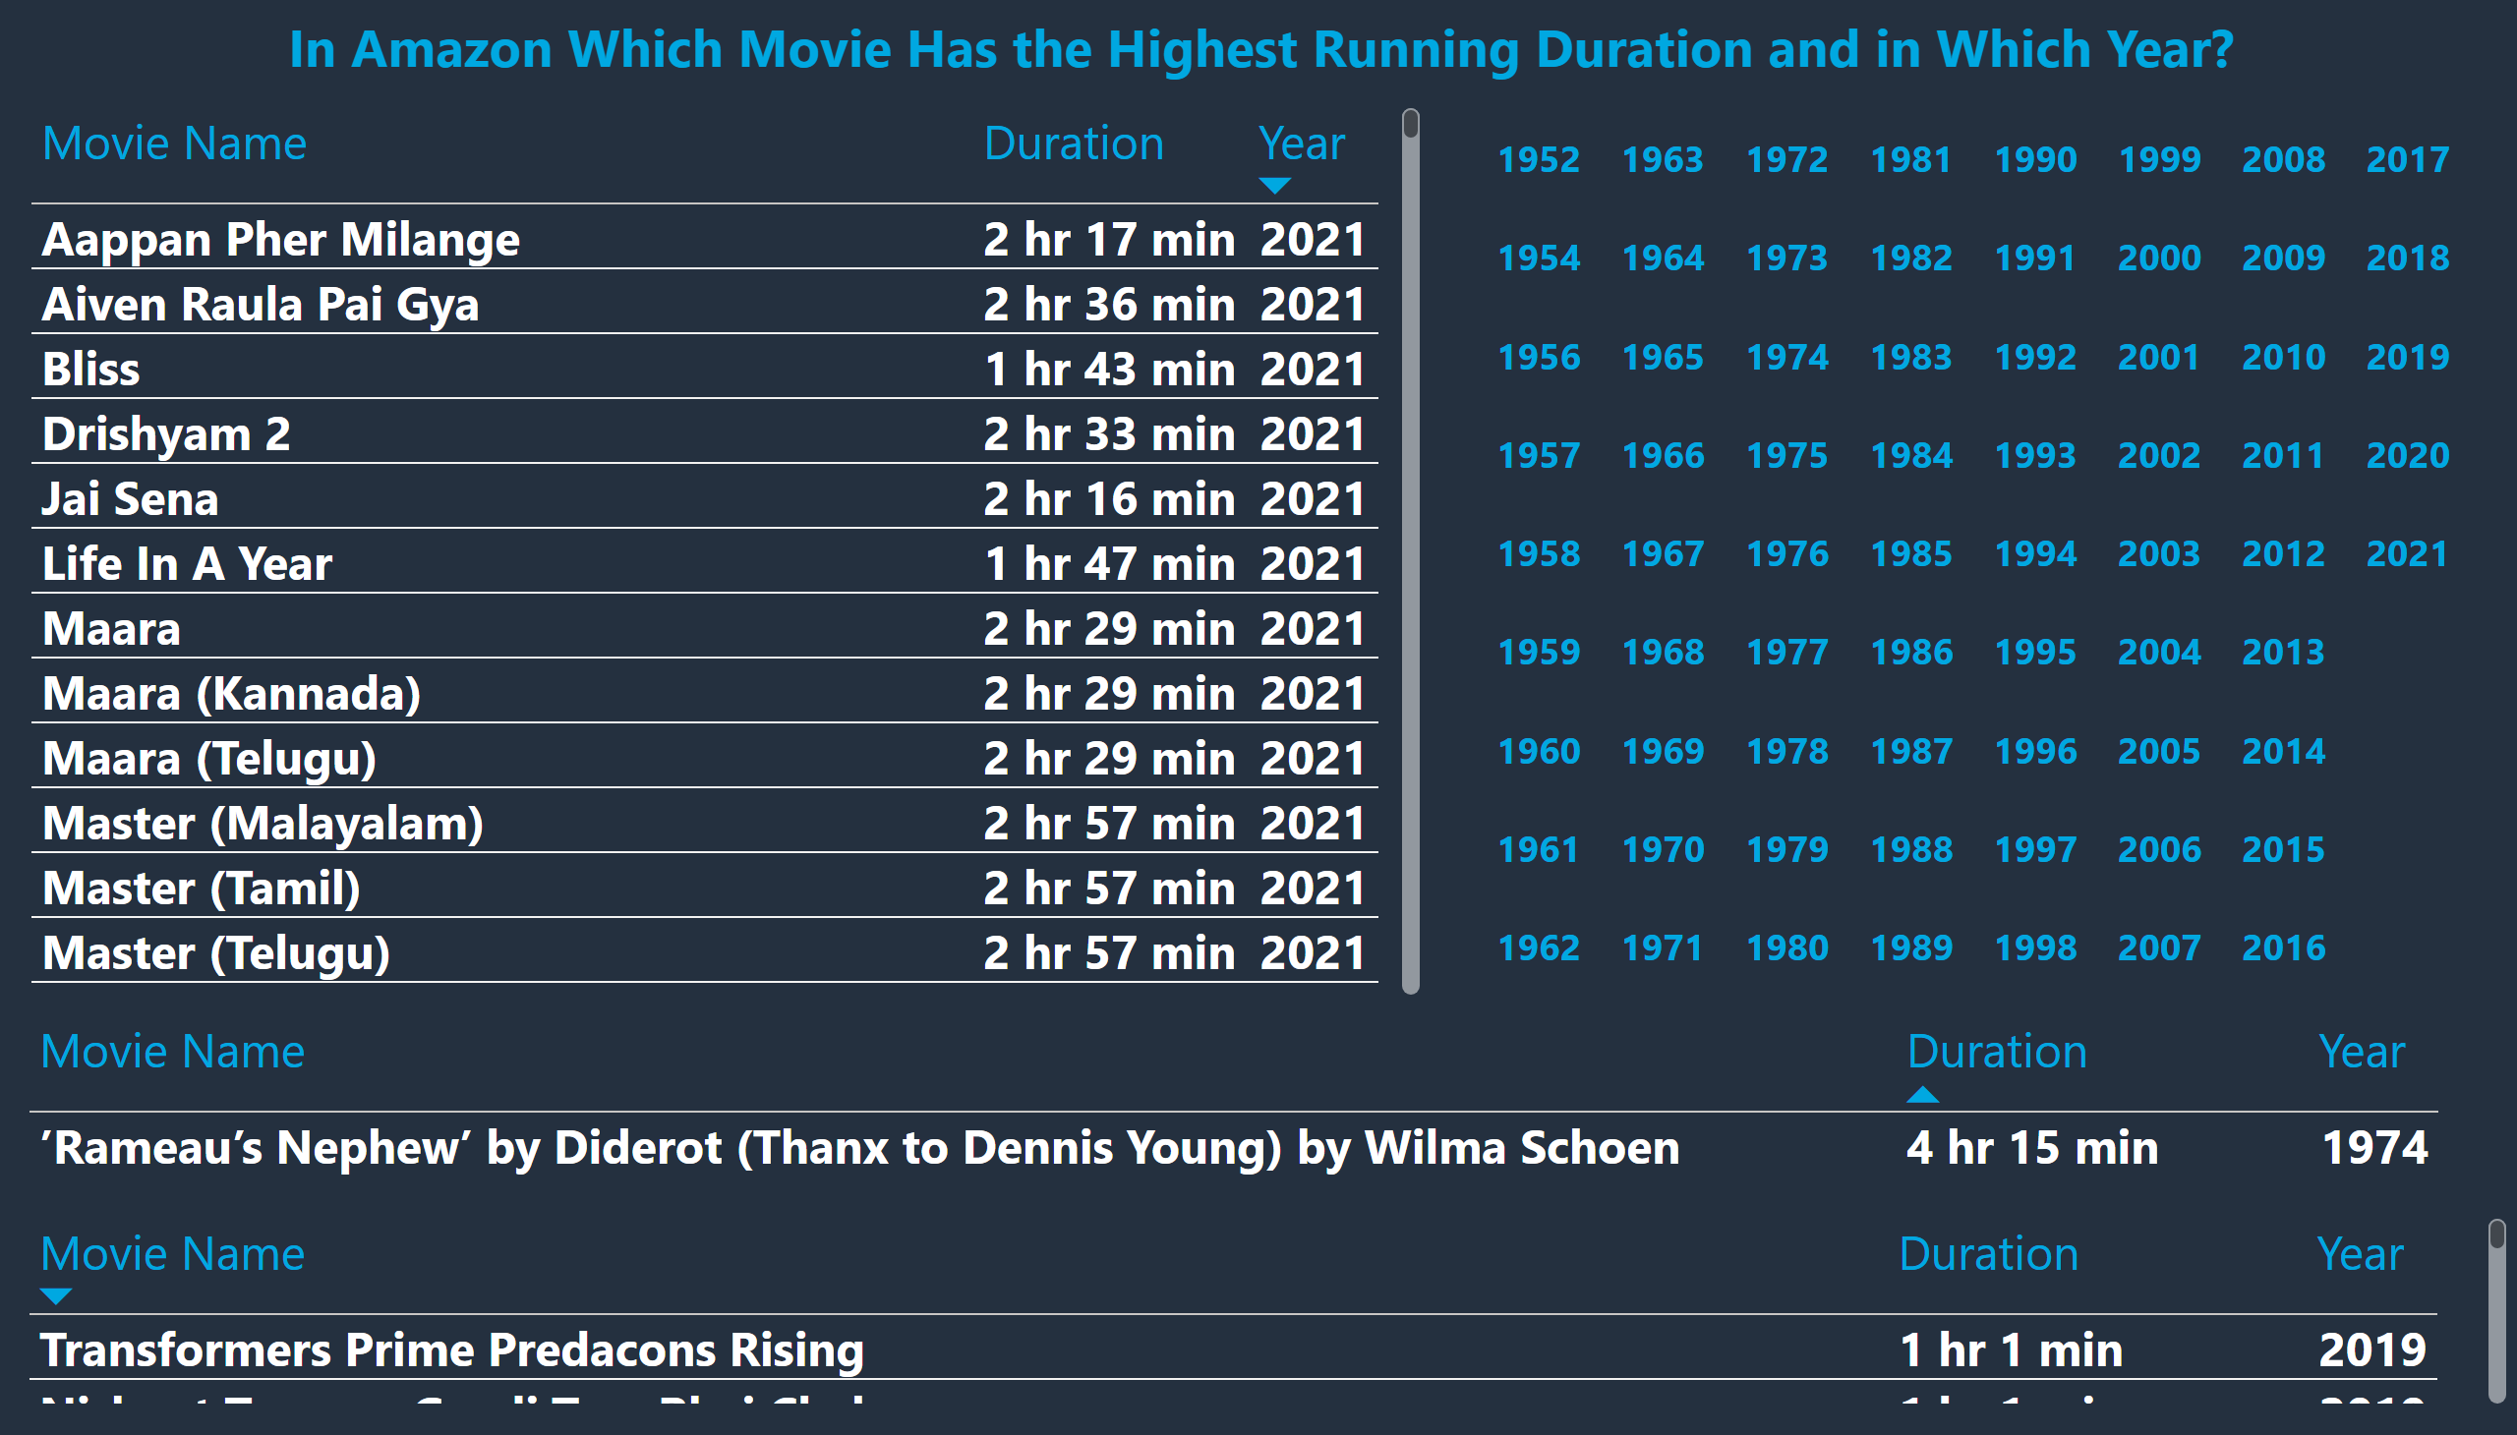
Amazon 4
Notes:
textbox
No alt text provided
tableEx
No alt text provided
slicer
No alt text provided
tableEx
No alt text provided
tableEx
No alt text provided

Slide 33
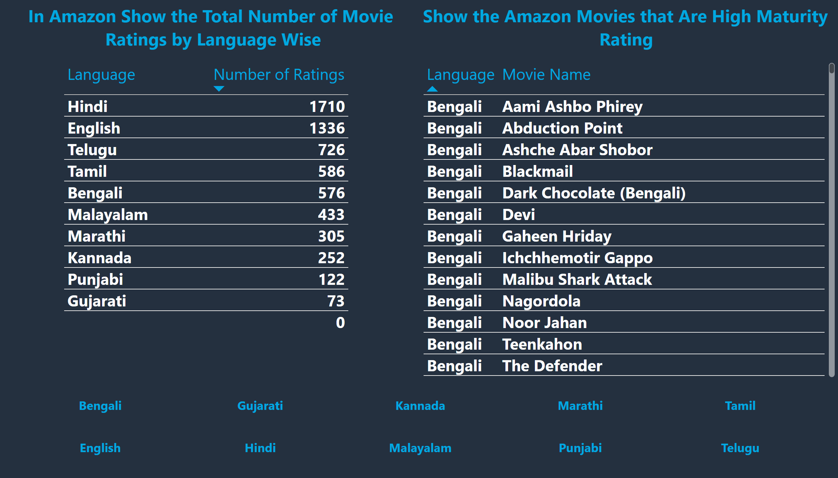
Amazon 5, 6
Notes:
textbox
No alt text provided
tableEx
No alt text provided
tableEx
No alt text provided
textbox
No alt text provided
slicer
No alt text provided

Slide 34
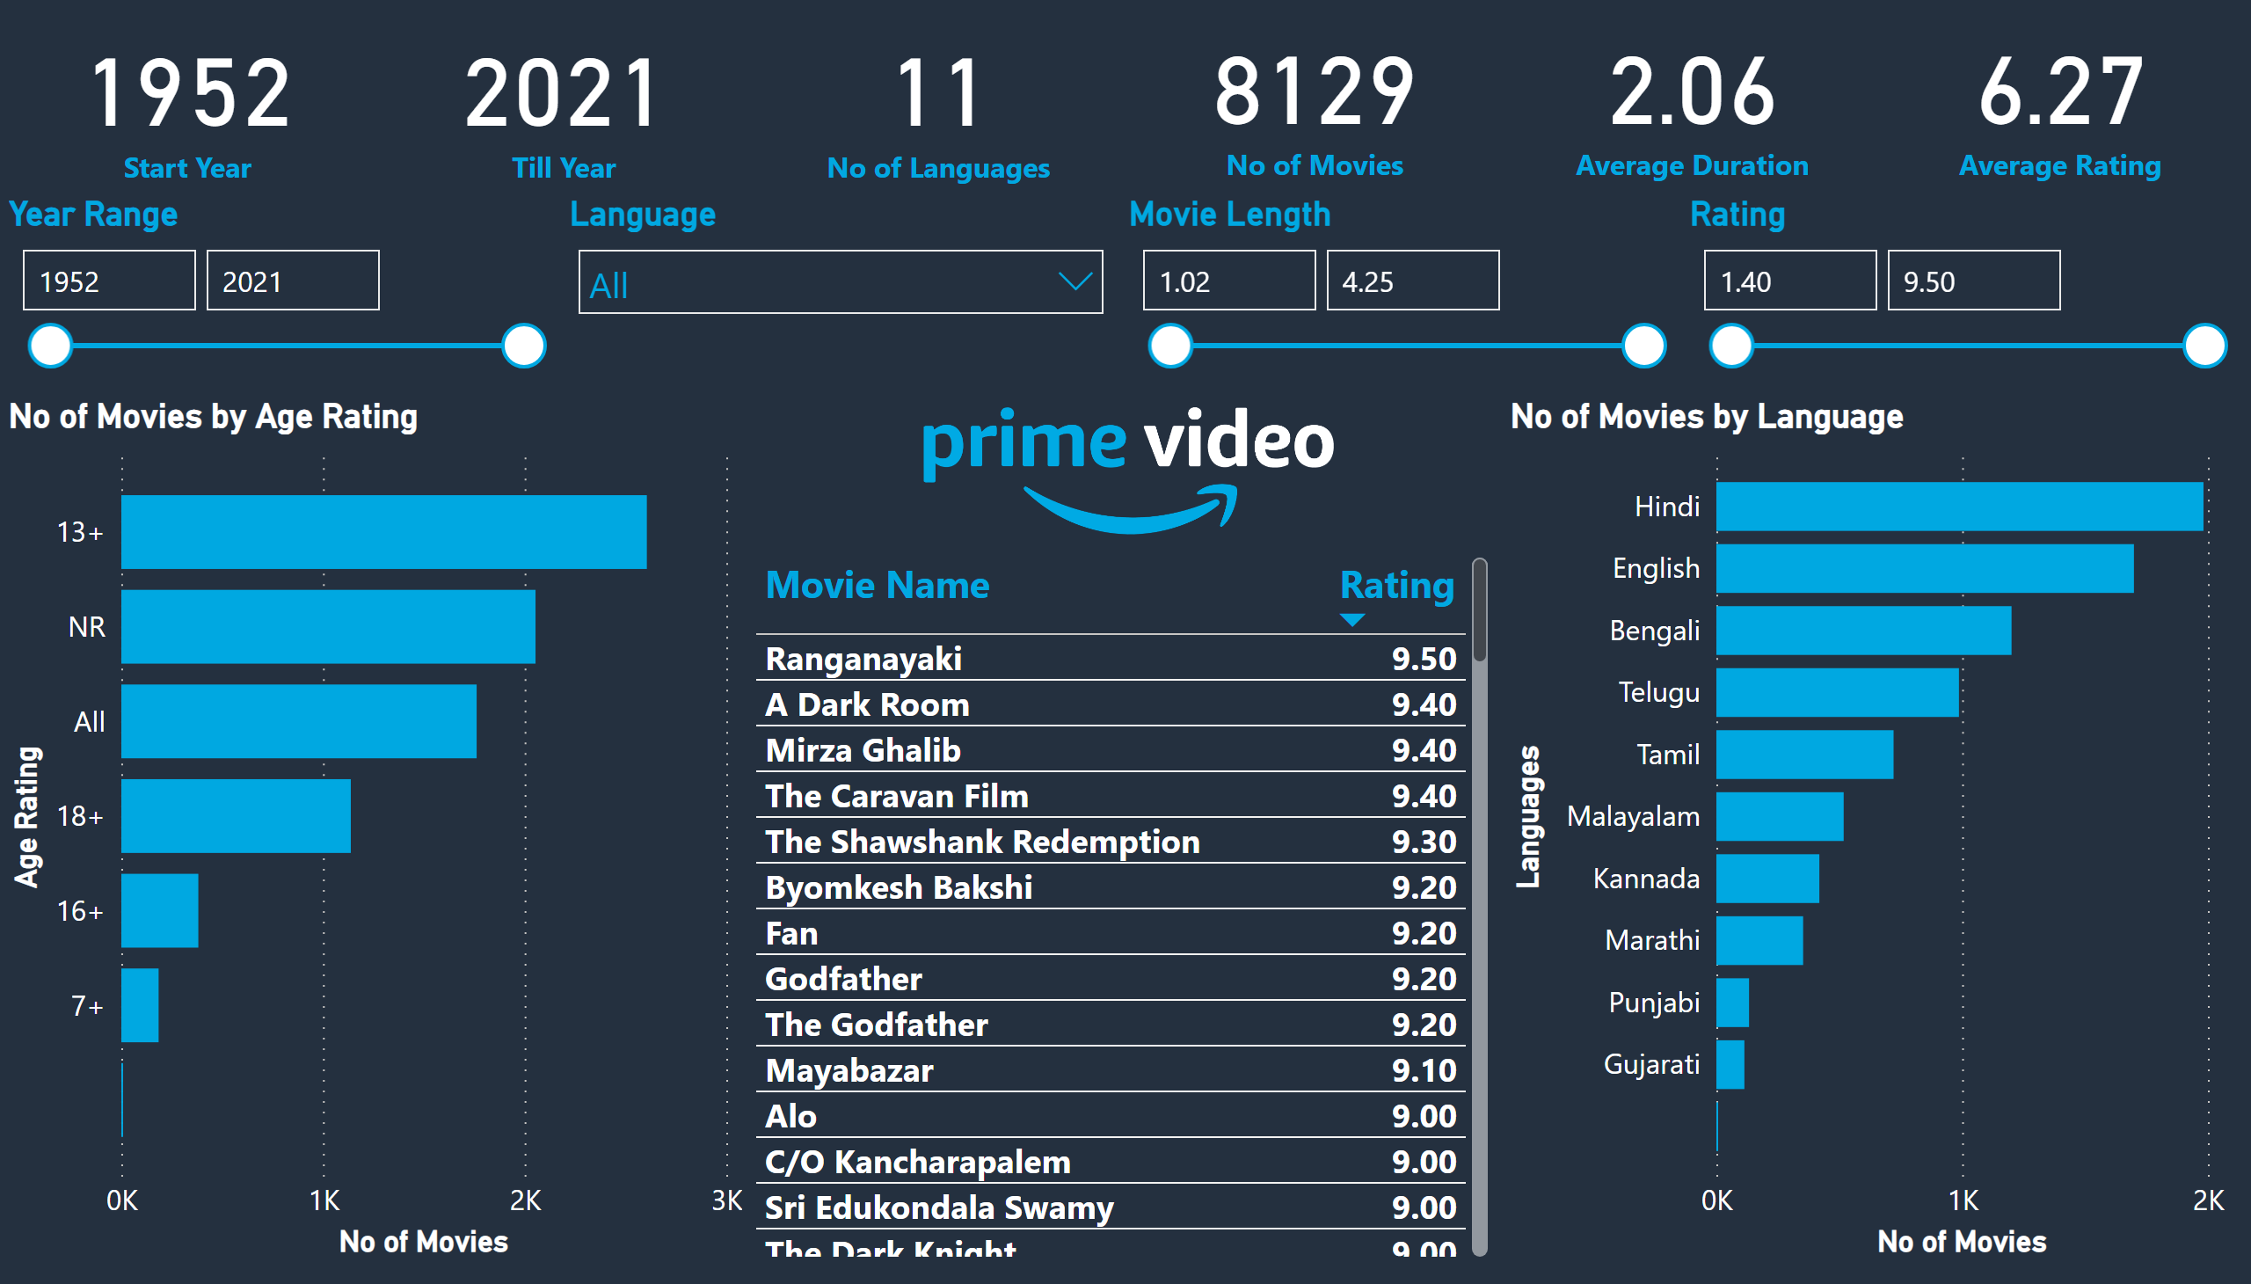
Amazon
Notes:
card
No alt text provided
card
No alt text provided
card
No alt text provided
card
No alt text provided
card
No alt text provided
card
No alt text provided
Year Range
No alt text provided
Language
No alt text provided
Movie Length
No alt text provided
Rating
No alt text provided
No of Movies by Language
No alt text provided
No of Movies by Age Rating
No alt text provided
image
No alt text provided
tableEx
No alt text provided

Slide 35
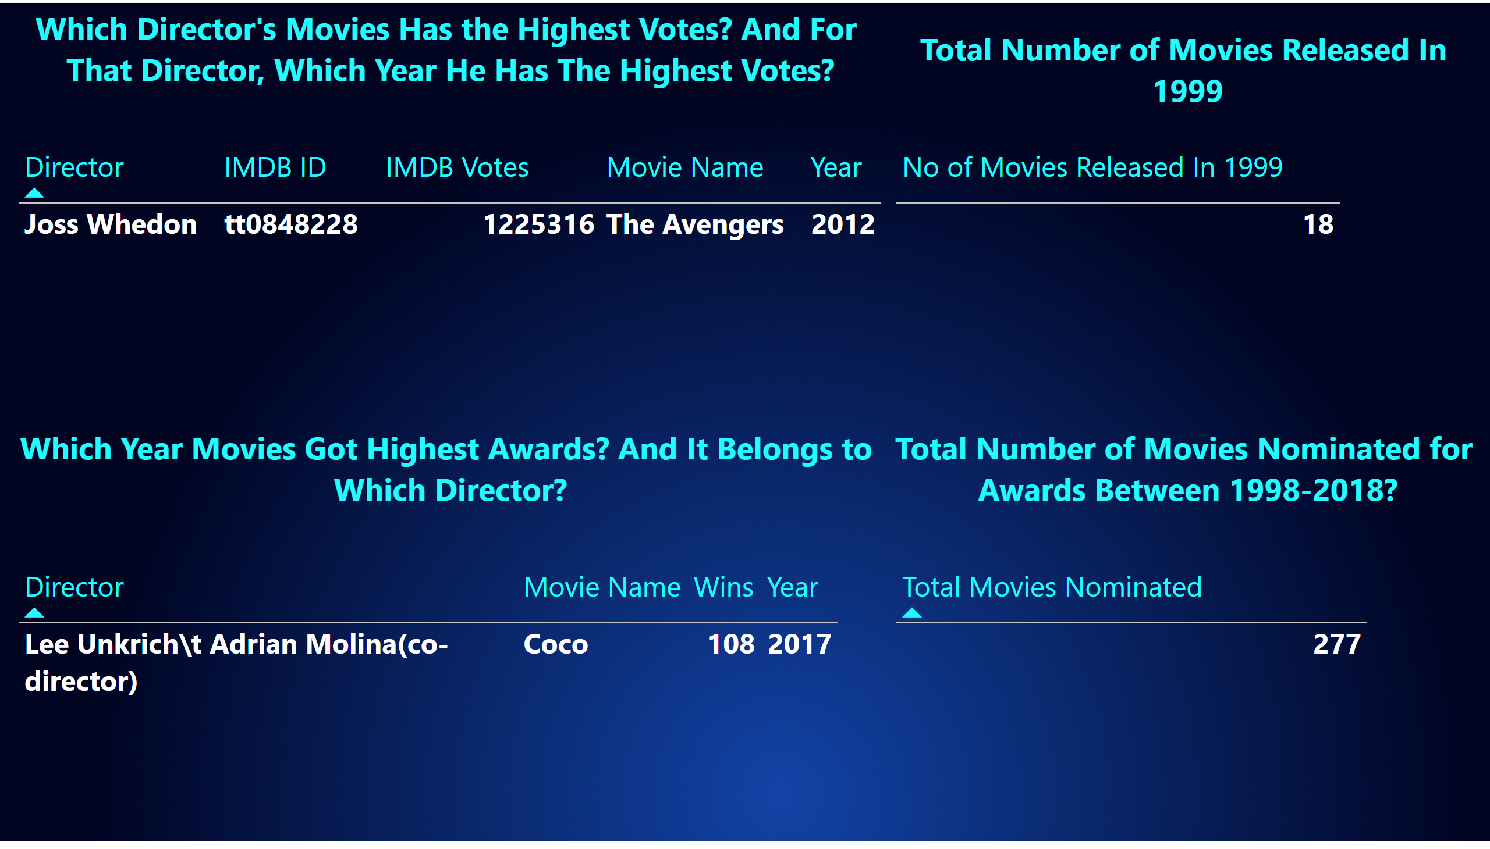
Disney 1, 2, 3, 4
Notes:
textbox
No alt text provided
tableEx
No alt text provided
textbox
No alt text provided
textbox
No alt text provided
textbox
No alt text provided
tableEx
No alt text provided
tableEx
No alt text provided
tableEx
No alt text provided

Slide 36
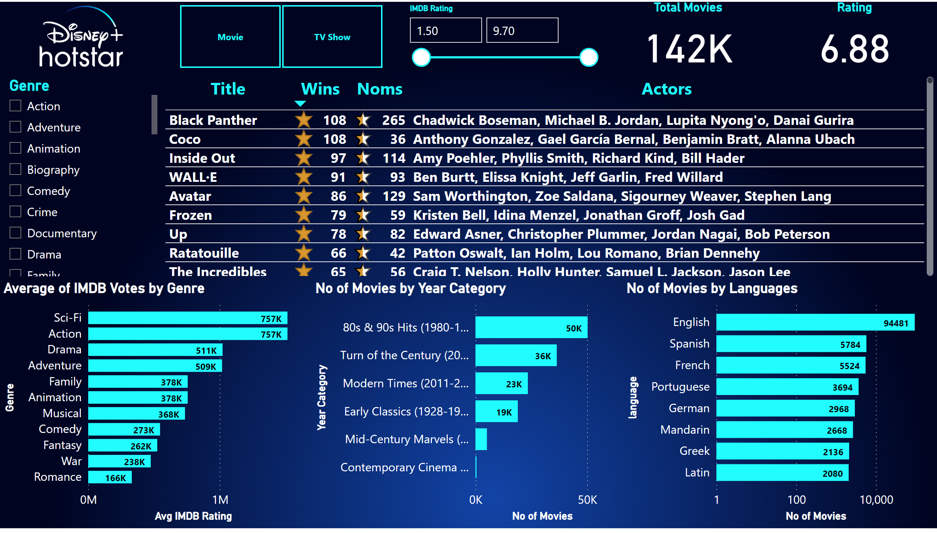
Disney
Notes:
slicer
No alt text provided
slicer
No alt text provided
efefe
No alt text provided
Average of IMDB Votes by Genre
No alt text provided
No of Movies by Year Category
No alt text provided
Total Movies
No alt text provided
Rating
No alt text provided
tableEx
No alt text provided
No of Movies by Languages
No alt text provided
image
No alt text provided

Slide 37
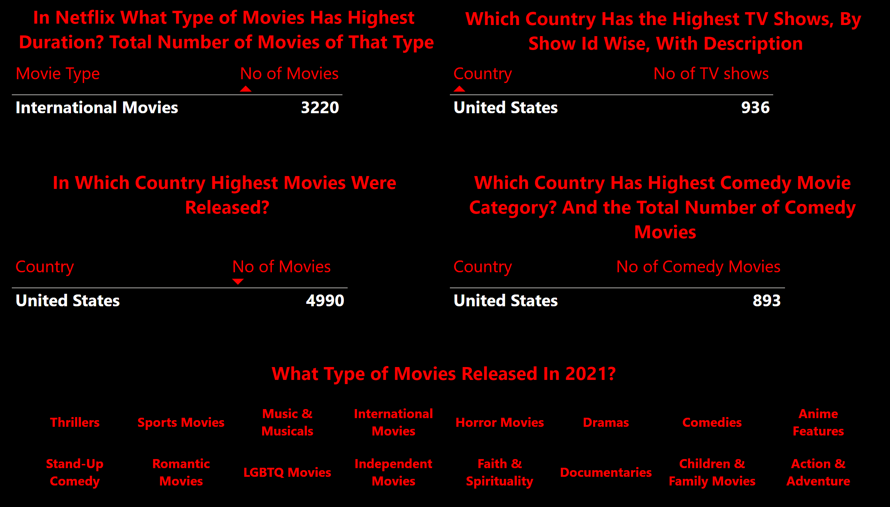
Netflix 1, 2, 3, 4, 5
Notes:
textbox
No alt text provided
tableEx
No alt text provided
textbox
No alt text provided
tableEx
No alt text provided
textbox
No alt text provided
textbox
No alt text provided
tableEx
No alt text provided
tableEx
No alt text provided
slicer
No alt text provided
textbox
No alt text provided

Slide 38
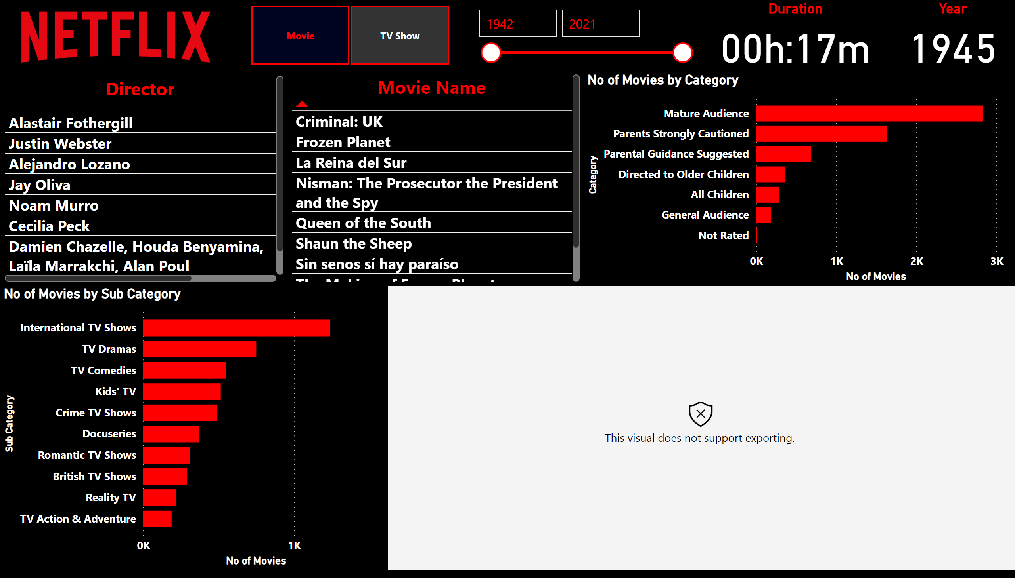
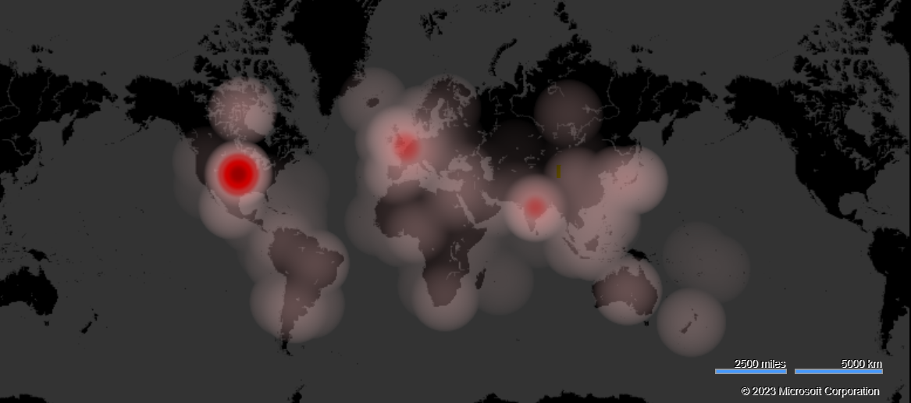
Netflix
Notes:
No of Movies by Category
No alt text provided
No of Movies by Sub Category
No alt text provided
tableEx
No alt text provided
slicer
No alt text provided
slicer
No alt text provided
Duration
No alt text provided
image
No alt text provided
tableEx
No alt text provided
Year
No alt text provided
heatmapF244EA9EE1F34E828A80CF19B41976F8
No alt text provided

Slide 39
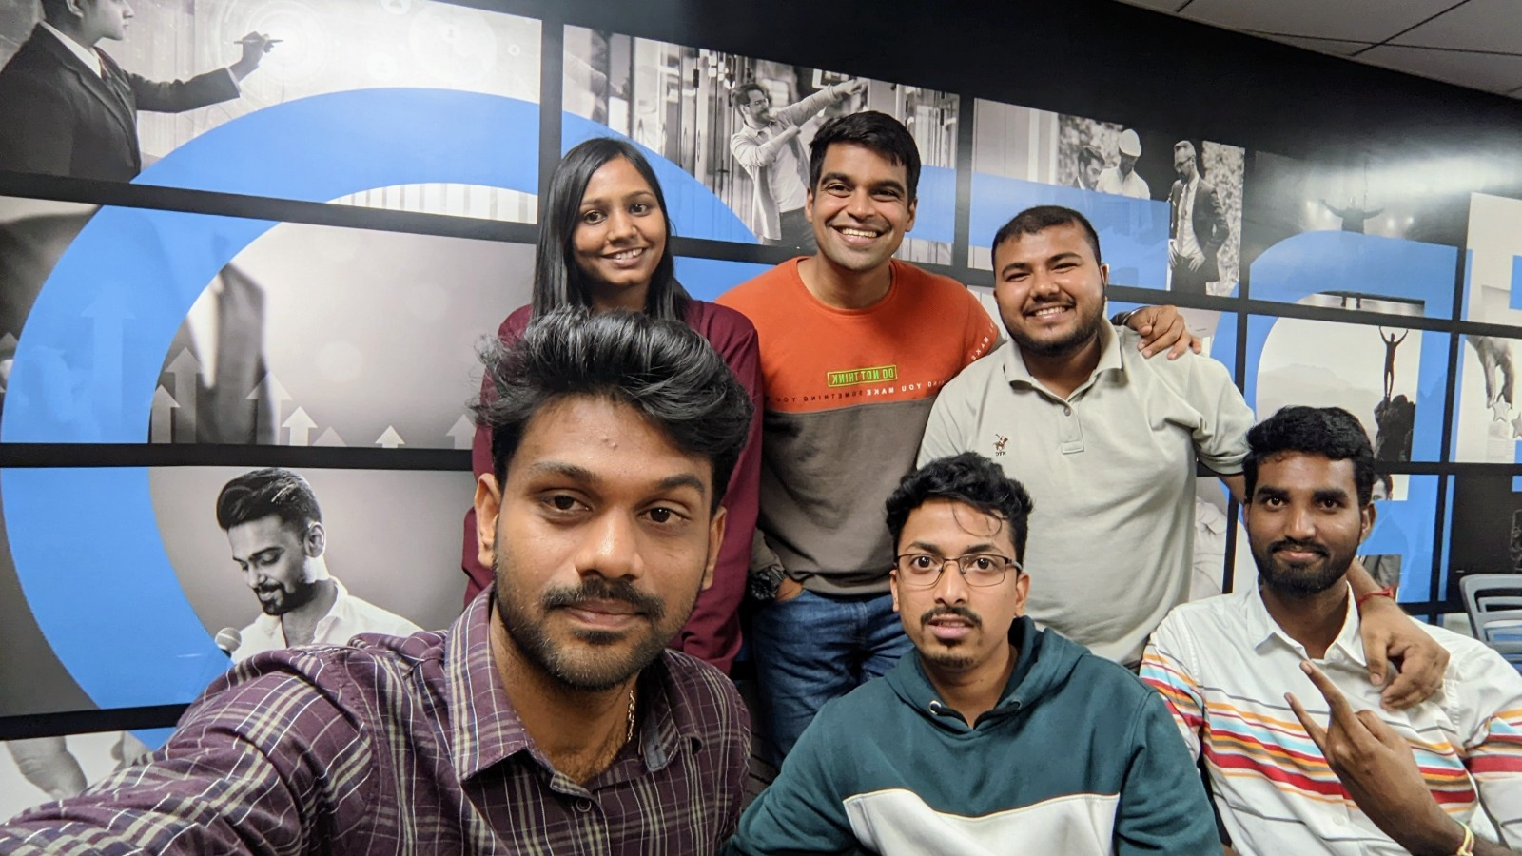
Agile Team Structure
Product Owner Amazon, Netflix, Disney + Hotstar
Scrum Master Vaishnavi Shahu
Scrum coordinator Kousik Dutta
Scrum Team Members Rajender Mudasthu ,Raghavendra Betageri, Sai Charan and Hari Teja
Sprint 1 week
User stories Building pipelines, analyzing and problem solving, building recommendation systems and developing dashboards .

Slide 40
Challenges Faced
Building the pipeline to NoSQL DB, which is CosmosDB.
Connecting synapse with Power BI , Took help of Sachin to solve issues that raised.
Running Databricks notebooks through ADF.
For mounting, unmounting and importing functions for problem solving .
Data features are less which created problem when getting the insights.

Slide 41
Conclusion
Developed pipelines for the data transfer from source to sink.
Analyzed in both on-premises and cloud platforms.
Connected all results from cloud to power BI and developed dashboards for the OTT platforms.
Build the Interactive dashboards, to recommend the movie based on the recruitment.

Slide 42

We sincerely thanks to our DE expert Venkat sir for guiding us to complete this project, it’s a team work from all of us after distributing the work among us We followed agile methodology for the progress of the project. There were cross checks, discussions, different perspectives from all of us to solve a particular problem.

